Slide 1
Group information:
Group-02
Sohel Rana 2017-3-60-043
Nu-A-Rayana 2018-1-60-131
Md. Tanvir Hassan 2018-1-60-236
Instructor Information:
Md. Mostafa Kamal Rasel, PhD
Assistant Professor,
Department of Computer Science & Engineering
Course Information:
CSE301 (DATabase system)
Section: 2
Date of Submission: 5/25/2021

Slide 2
Topic: Paper Reading on “Cohort Query Processing”
Paper L ink: http://www.vldb.org/pvldb/vol10/p1-ooi.pdf Paper Accepted Year: 2016
43rd International Conference on Very Large Data Bases

Slide 3
Introduction
Paper Name: Cohort Query Processing
expensive to evaluate.
extending SQL with three new operators.
It is hard to draw meaningful insights from activity data tabulation.

Slide 4
Introduction
With Cohort analytics, social scientists study the human behavioral trend in three steps
Group users into cohorts;
Determine the age of user activities;
Compute aggregations for each (cohort, age) bucket.

Slide 5
Related Work
SQL GROUP BY operator and aggregate functions.
Row-oriented databases are in-efficient for CUBE style OLAP analysis
materialized view, OLAP queries.

Slide 6
Related Work
OLAP queries be used to accelerate the processing of cohort queries
The cohort analysis approach presented in social science literatures has two limitations:
specify-ing a subset of users or activity tuples for analysis;
Only use time attribute to identify cohorts.

Slide 7
Motivation
columnar database system, compared against the two non-intrusive
apply traditional SQLGROUP BY operators.
Finding unusual user behavioral trends.

Slide 8
Motivation
To study the human behavioral trend
partitioning activity tuples.
existing relational DBMS and express the cohort analysis task as a SQL query

Slide 9
Problem Statement
dataset containing user activities collected from a mobile game.
Solving insight of average gold.
Developing a columnar based query engine named COHAHA, for efficient cohort query processing.

Slide 10
Proposed Idea
Non-intrusive approach to cohort analytics
Cohort analysis foundations
Data model
Cohort operators
The cohort query
Extensions
Cohana: cohort query engine
The activity table storage format

Slide 11
Proposed Idea
Cohort query evaluation
The table scan operation
Cohort algorithms
Optimizing for user retention analysis
Analysis of Query Performance
Benchmark Queries
Performance Study of COHANA

Slide 12
Contribution
Cohort analytics in the context of a DBMS.
Relationship to model user activity data for cohort analytics.
introduce three new operators.
Tasks can be expressed using a mix of traditional SQL clauses and the newly proposed operators.

Slide 13
Contribution
Built cohort query engine, CO-HAHA
mostly optimized counterpart.

Slide 14
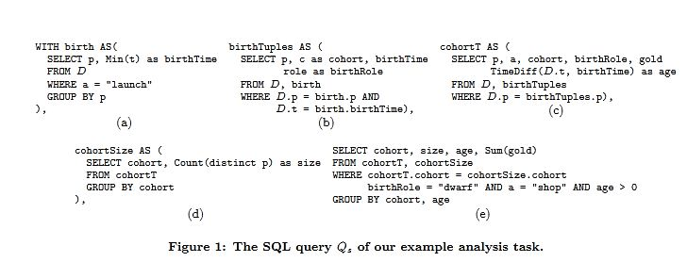
Details of proposed technique
A NON-INTRUSIVE APPROACH TO COHORT ANALYTICS

Slide 15
Details of proposed technique
Figure 1 shows the corresponding SQL query Qs for this task. To save space, we use p, a, t, c abbreviations respectively to denote the player, action, time, and country attribute in Table 1. The Qs employs four sub-queries (i.e., Figure 1(a) – Figure 1(d)) and one outer query (i.e., Figure 1(e)) to produce the results. Overall, this SQL approach performs poorly for three reasons:
•The SQL statement Qs is verbose, and its complexity renders it prone to mistakes.
•The SQL statement Qs requires many joins to perform the analysis task. As we shall see in our experimental study, such a query processing scheme can be up to 5orders of magnitude slower than our proposed solution.

Slide 16
Details of proposed technique
It requires manual tuning. For example, one may no-tice that we can push the selection condition (i.e,birth Role = "dwarf") from the outer query (Figure 1(e))to the inner sub-query (Figure 1(c)) to reduce the size of intermediate tables. Ideally, such an optimization can be performed by an intelligent optimizer. How-ever, our evaluation shows that few database system scan perform such an optimization. To speed up the processing of the analysis task, we can adopt materialized view(MV) approach that stores some intermediate results. For example, we can materialize the intermediate table cohort produced by the sub query in Qs(Figure 1(c)) as follows.

Slide 17
Details of proposed technique
COHORT ANALYSIS FOUNDATIONS
To extend an existing relational database system to support cohort analytics.

Slide 18
Details of proposed technique
DATA MODEL
An activity table D is a relation with attributes Au,At,Ae,A1,...,An where n≥1.Au is a string uniquely identifying user.
Ae is also a string, representing an action chosen from a predefined collection of actions.
At records the time at which Au performed Ae.

Slide 19
Details of proposed technique
COHORT OPERATORS
The σbC,e Operator
σbC,e (D)={d∈D|i←d[Au]∧C(di,e) = true}where C is a propositional formula and e is a birth action.

Slide 20
Details of proposed technique
The σgC,e Operator
σgC,e(D) ={d∈D|i←d[Au]∧((d[At] =ti,e)∨(d[At]> ti,e∧C(d) = true))}where C is a propositional formula and e is a birth action
TheγcL,e,fAOperator
Given an activity table D, the cohort aggregation operator γcL,e,fAis defined as
γcL,e,fA(D)={(dL,g,s,m)|Dg←{(d,l,g)|d∈D∧i←d[Au]∧l=di,e[L]∧g=d[At]−ti,e}∧(dL,g)∈πl,g(Dg)∧s= Count(πAuσdg[l]=dL(Dg))∧m=fA(σdg[l]=dL∧dg[g]=g∧g>0(Dg))where L is a cohort attributes set,e is a birth action and fA is a standard aggregation function with respect to the attribute A.

Slide 21
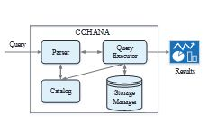
Details of proposed technique
COHANA: COHORT QUERY ENGINE
To support cohort analytics with the newly designed cohort operators, they have present four extensions to a columnar database:
A fine tuned hierarchical storage format for persisting activity tables;
A modified table scan operator capable of skipping age activity tuples of unqualified users;
A native efficient implementation of cohort operators;

Slide 22
Details of proposed technique
COHORT ALGORITHMS
This section develops algorithms for the implementation of cohort operators over the proposed storage format for activity tables.

Slide 23
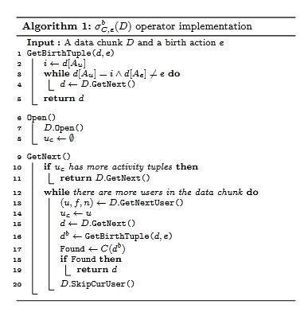
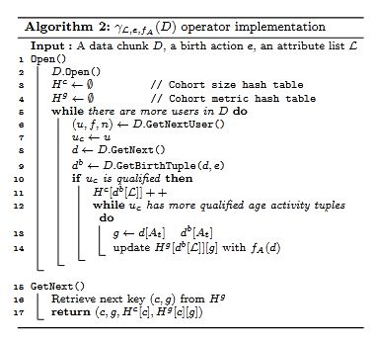
Details of proposed technique

Slide 24
Result
Performance Study of COHANA
Effect of Chunk Size

Slide 25
Result
Effect of Birth Selection
They claim that the running time of CO-HANA is bounded by O(n) wherein the total number of qualified users. This experiment studies the query performance of COHANA with respect to the birth selection selectivity. We run Q5 and Q6, which are respectively a variant of Q1 and Q3, by fixingd1 to be the earliest birth date, andincrementingd2 by one day each time. The dataset used in this experiment is at scale 1.

Slide 26
Result
Effect of Age Selection
In this experiment, they ran Q7 and Q8, another variant ofQ1 and Q3, on the dataset of scale 1 by varying from 1day to 14 days to study the query performance of COHANA under different age selection conditions. Figure 8 presents the result of this experiment. As in Figure 7, the process-ng times of Q7 and Q8 are also respectively normalized by that of Q1 and Q3. It can be seen from this figure that the processing times of Q7 and Q8 exhibit different trends.

Slide 27
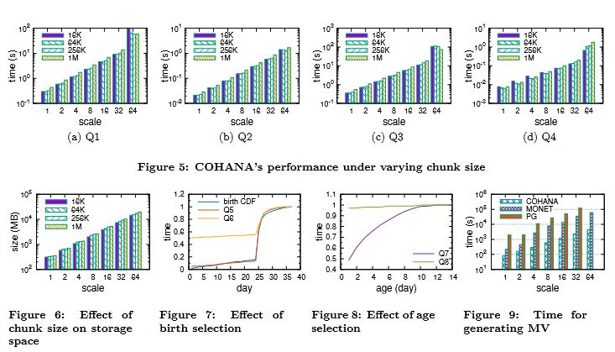
Result

Slide 28
Author’s Observation
finding unusual user behavioral trends.
Investigation of database support for cohort analysis.
Modeling activity data and ex-tended SQL.
Developed a columnar based query engine, COHAHA.

Slide 29
Students’ Observation
COHANA can achieve two orders faster query performance.
Demonstrating the possible benefit of extending a database system.
COHANA, performs extremely well in both small and big database.
COHANA is able to perform better than the MonetDB.
Materialized view is much more expensive than COHANA.

Slide 30
THANK YOU

